Slide 1
Ensembling
Rick Fontenot
SMU DS7335 Machine Learning II
rickfontenot@gmail.com

Slide 2
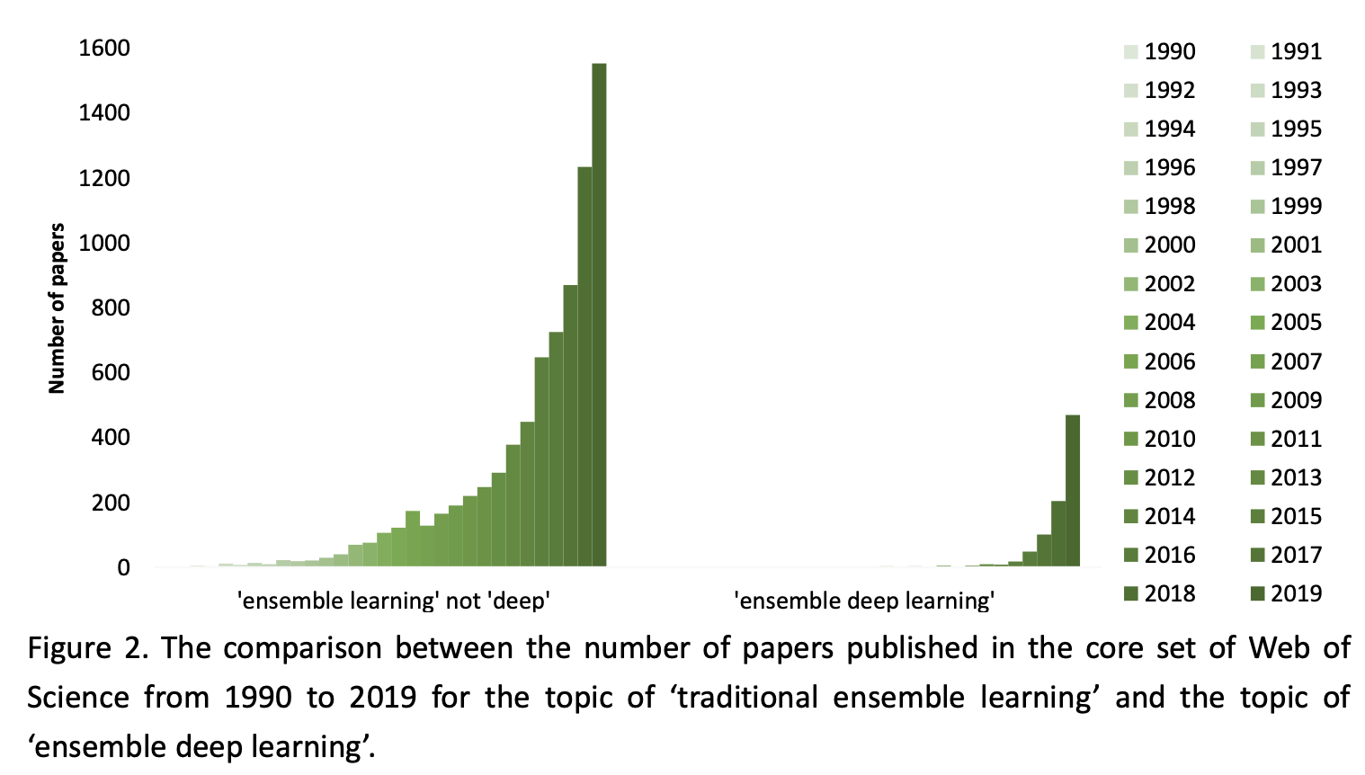
Rapid Rise in Research
Traditional Ensemble Learning (TEL)
Ensemble Deep Learning (EDL)
Yongquan Yang et. al “A Survey on Ensemble Learning under the Era of Deep Learning” 2021

Slide 3
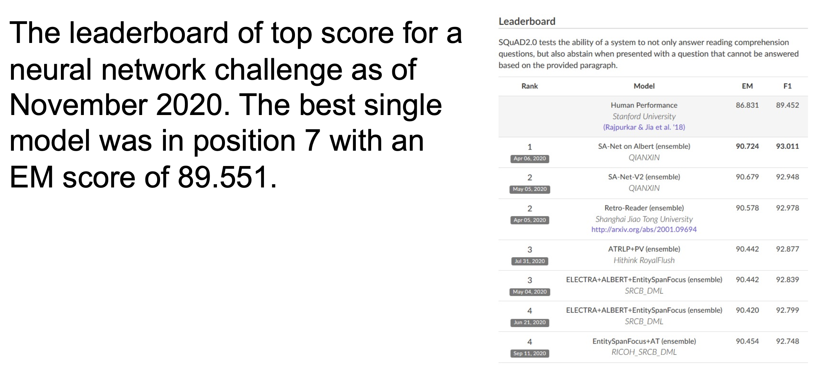
Popularity in Competitions
Slide From Dr. Slater’s Quantifying the World Course

Slide 4
Counterpoint & Considerations
“More often than not, winners of Kaggle competitions have used ensemble methods…while they are a popular choice for ML competitions, they are not used in production in the “real world” quite as often as we might expect” --Philip Tannor, CEO of Deepchecks (uses Explainable AI to check and monitor ML models)
When you shouldn’t use Ensemble Learning:
Can’t afford extra overhead in training and inference time
If your model must operate in real-time it needs to be lean to reduce latency.
Additional training time if you need to regularly retrain to avoid model drift.
Lack of explain-ability
Tanoor al “When You Shouldn’t Use Ensemble Learning” 2021
https://deepchecks.com/when-you-shouldnt-use-ensemble-learning/

Slide 5
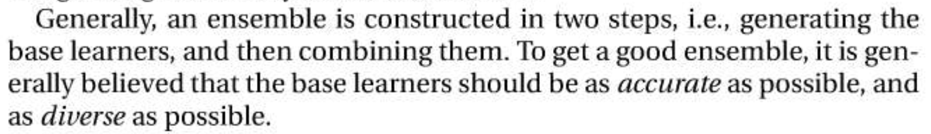
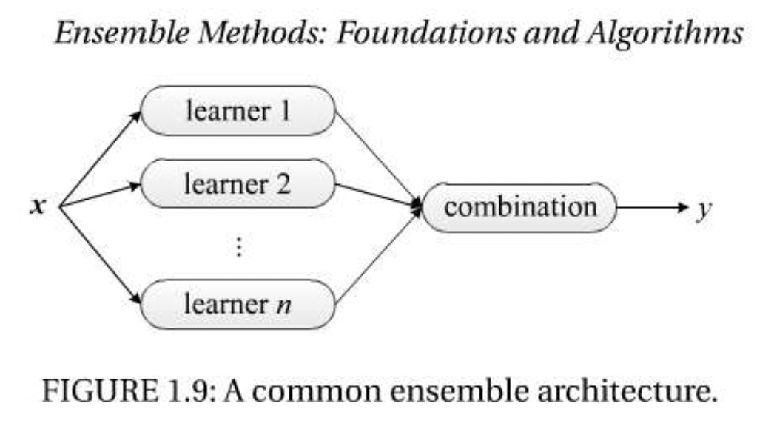
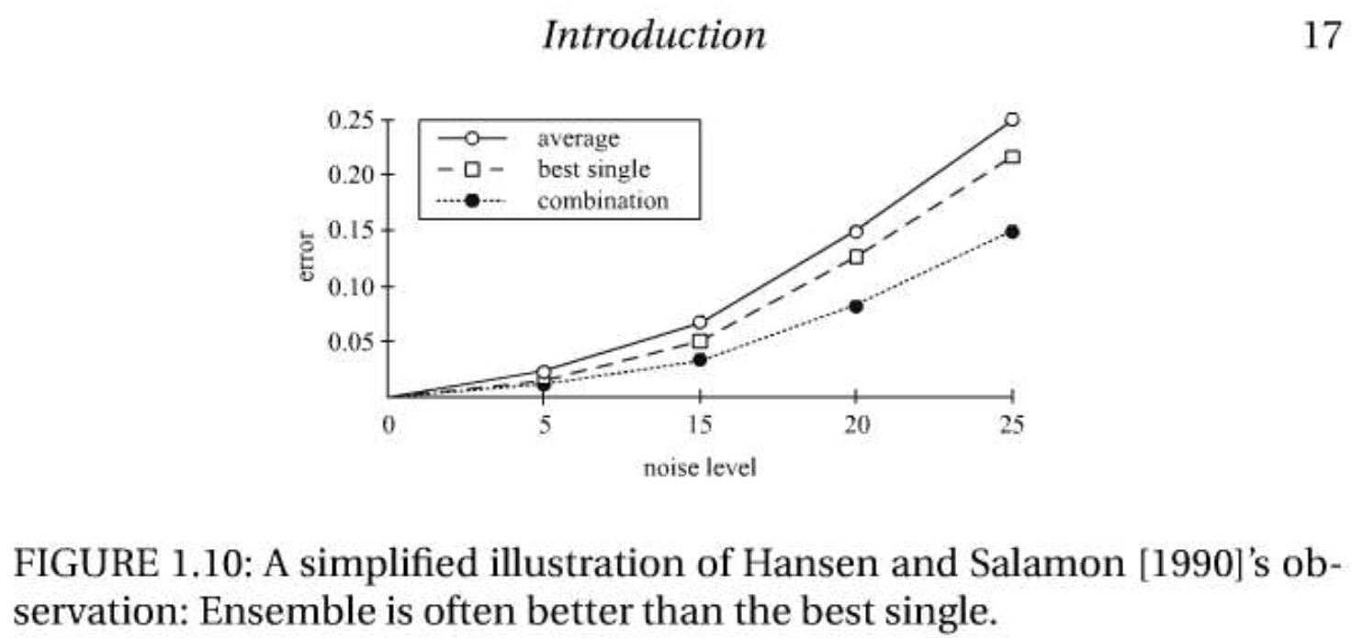
Basic Approach
Zhi-Hua Zhou “Ensemble Methods: Foundations & Algorithms” 2012

Slide 6
Combination Methods
Numerical predictions:
Simple Averaging
Weighted averaging
Classification:
Majority voting – if a class receives more than 50% votes between base learners that becomes the ensemble prediction. If no class receive 50% then there is no ensemble prediction and you can default to a class or choose one base learner’s results as default.
Plurality voting – simply choose the class with the most votes between all base learners
Weighted voting
Soft voting – rather than using hard classifications from each base learner, average their prediction probabilities. This can be weighted averaging similar to above
Meta Learners:
Combination determine by more complex models such as regression, random forest, neural networks or an appropriate type
Can be used for Numerical or Classification predictions

Slide 7
Meta-Learners
Base Learners
Logistic Regression
Meta Learner
Any ML Model
Probabilities
Predictions
(Can be class or probabilities)
Random Forest
Training
Data
XGBoost
Neural Network

Slide 8
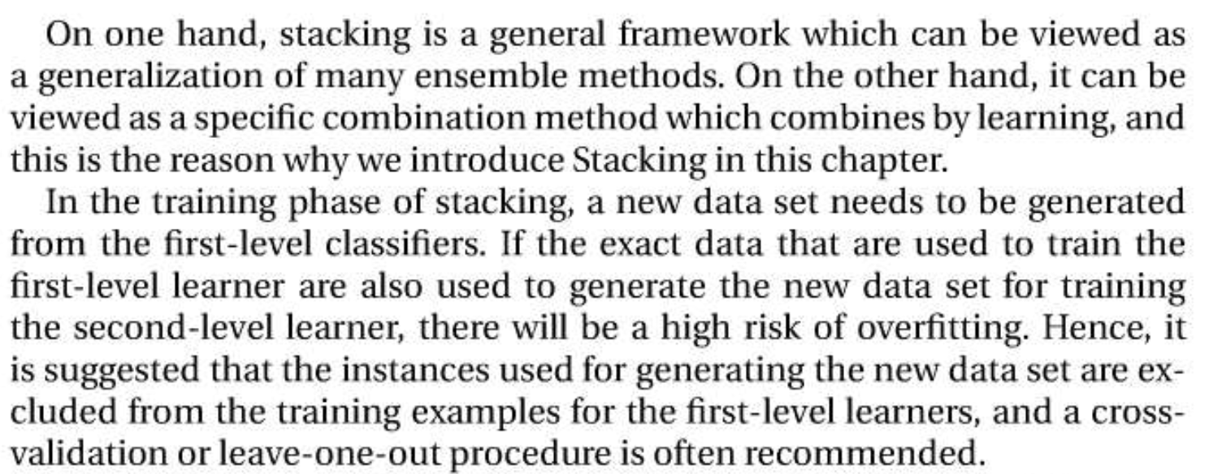
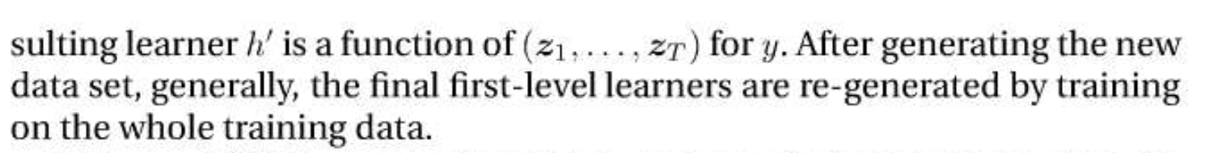
Assumptions: Out-of-fold predictions
Zhi-Hua Zhou “Ensemble Methods: Foundations & Algorithms” 2012

Slide 9
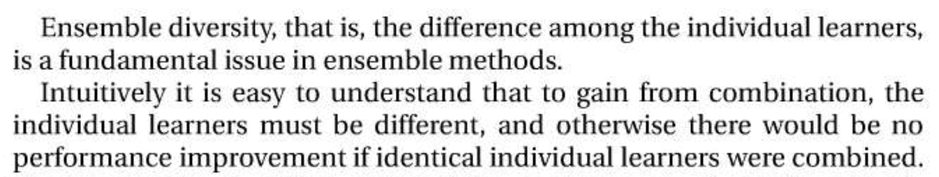
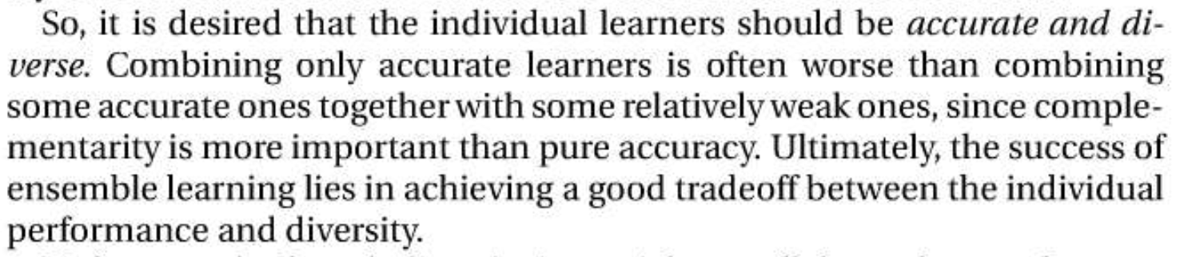
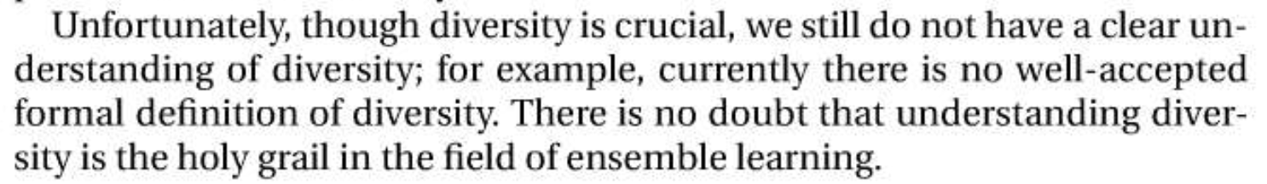
Assumptions: Model Diversity
Zhi-Hua Zhou “Ensemble Methods: Foundations & Algorithms” 2012

Slide 10
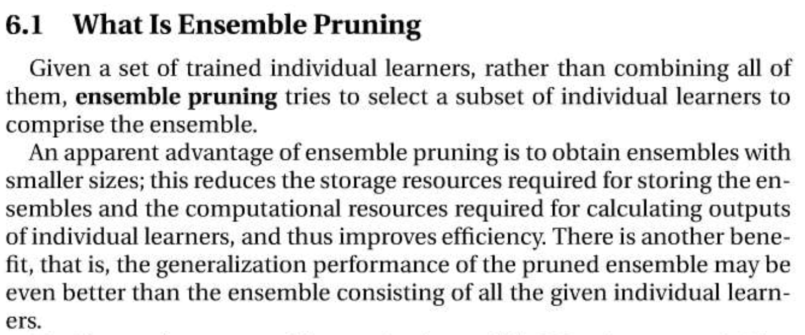
Assumptions: Pruning
Zhi-Hua Zhou “Ensemble Methods: Foundations & Algorithms” 2012

Slide 11
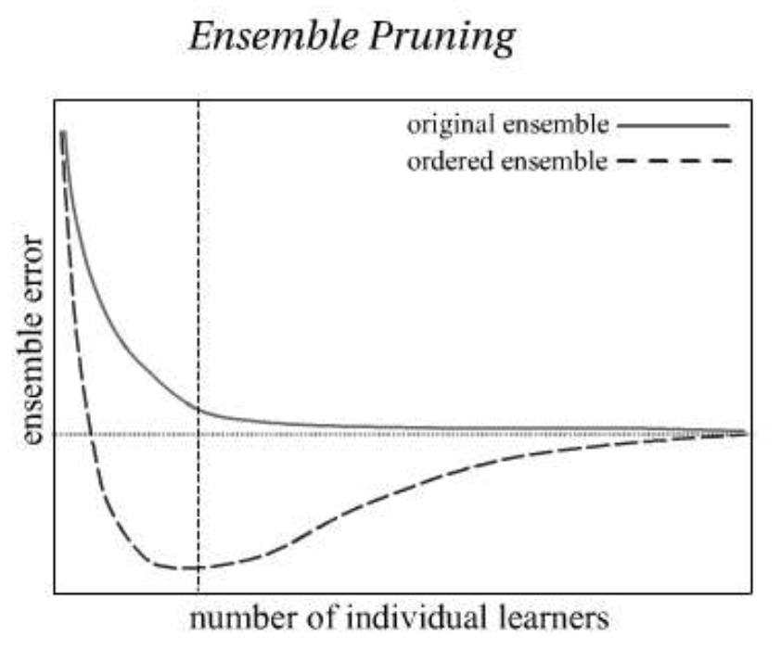
Assumptions: Pruning
Order of base learners in pruning process can be ranked:
by lowest validation error
by highest diversity pairings of base learners
Forward Selection
If the order is random, you may not find the optimal pruned mixture
Zhi-Hua Zhou “Ensemble Methods: Foundations & Algorithms” 2012

Slide 12
demonstration
Case study to explore effects of ensemble assumptions & compare results and modeling time

Slide 13
Background info on case for demo
Anonymized data set with 45 numeric features and 5 string features
Target is binary and also anonymized, client wants predictions to decide what actions to take on each transaction
Incorrect predictions cost the client money on each transaction, $100 for a false positive and $200 for a false negative
Cost function was set up to sum all these costs on prediction set then divide by total predictions to normalize to Average Money Lost per transaction
The client has approximately 160,000 transactions annually, so the annual value of savings can be estimated for each model
Goal is to minimize money loss (not maximize accuracy)

Slide 14
Neural Network Meta-Learner
Base Learners
Logistic Regression
Neural Network Meta Learner
5 dense layers with 300 neurons
Probabilities
Predictions
(Sigmoid Function)
Random Forest
Training
Data
XGBoost
Neural Network

Slide 15
Base Learner Models
Neural Network (NN) is best individual model
NN train time is longer, creating out-of-fold predictions on training set much longer
Time to create validation set predictions is negligible after models are trained
Will validation set have large enough sample size for meta-learner ensemble?

Slide 16
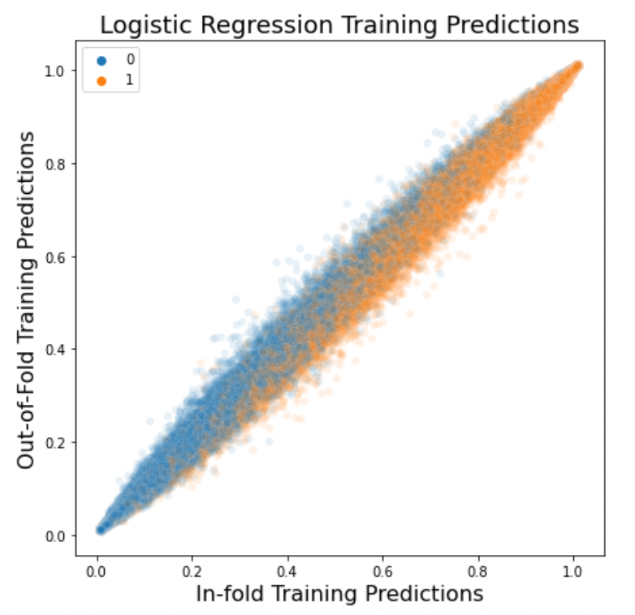
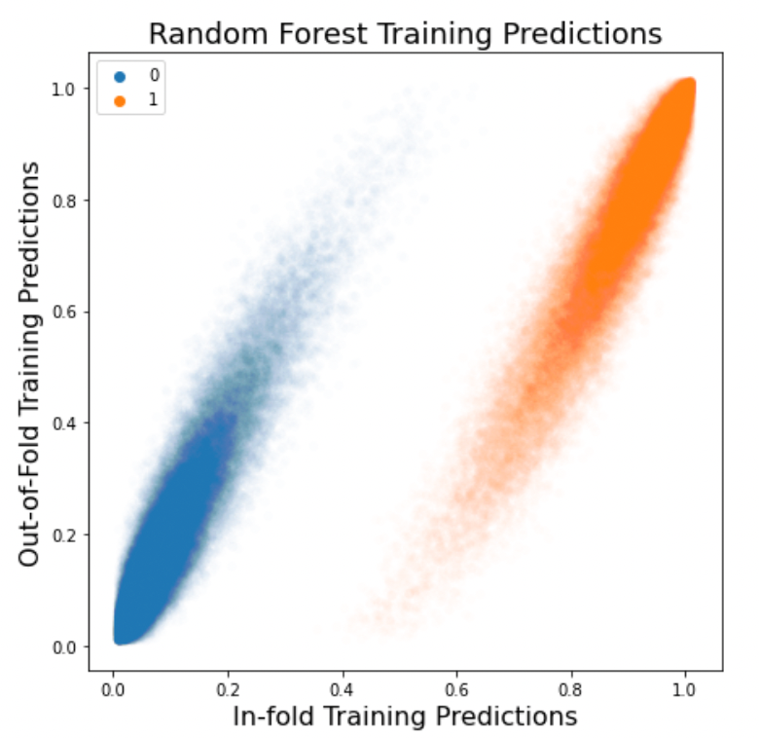
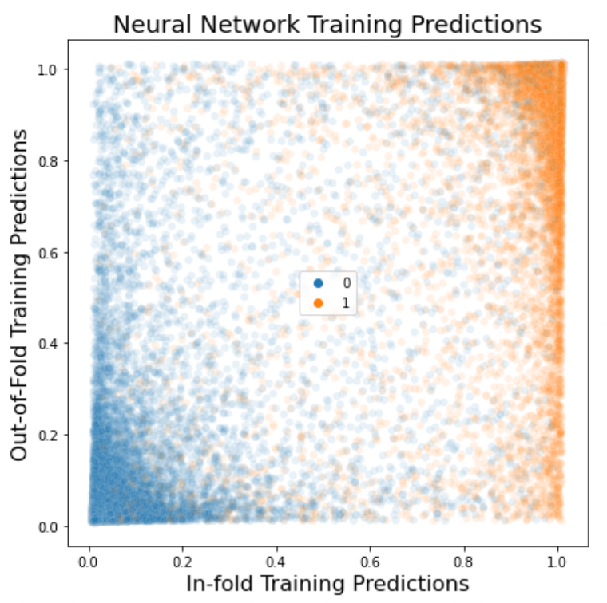
In-fold vs. out-of-fold predictions
Predictions are relatively similar in linear model, but more significantly different in more complex models prone to overfitting
With a 0.5 cutoff, the 0/1 classifications have similar error rates but the probabilities are what feed as inputs to meta-learner so the differences can be significant when overfit

Slide 17
Comparison of Ensembles trained from in-fold vs. out-of-fold predictions
All 4 base learners included in a neural network meta-learner ensemble
Using In-fold probabilities from base learner performed significantly worse than not ensembling at all (predictions were overfit)
Out-of-fold predictions on smaller validation set performed as well as larger training set
For this case study, additional time to create out-of-fold predictions on training set not worth the time, but in other cases with smaller sample sizes it may be advisable

Slide 18
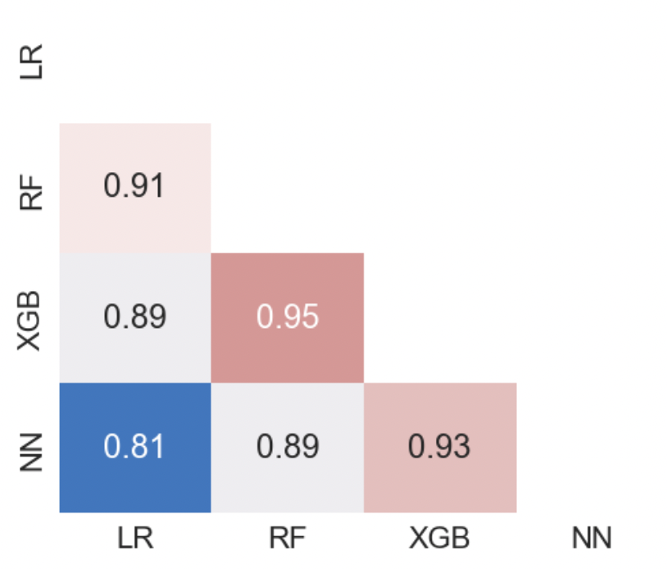
Pruning Exercises by Ranking Order
Correlation Matrix for OOF predictions
Pruning Ex. 1
Order by Best Loss:
Neural Network
XGB Classifier
Random Forest
Logistic Regression
Pruning Ex. 2
Order by Diversity:
Neural Network
Logistic Regression
Random Forest
XBG Classifier
Pruning Ex. 3
Order Randomly:
Neural Network
Random Forest
Logistic Regression
XBG Classifier

Slide 19
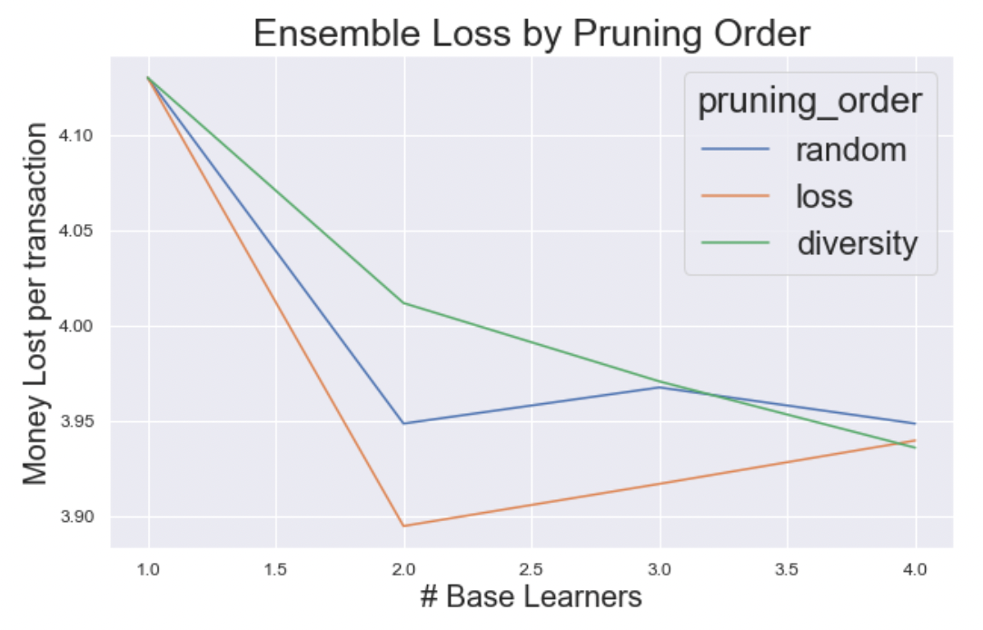
Pruning a Neural-Network Meta-Learner
Ranking by Loss produced the best ensemble with just two learners
Reducing base learners to just NN & XGB lowers loss and saves time vs. using all 4 base learners

Slide 20
Comparison of ensemble models
Best Ensemble saves $38,400 annually with less than 3 additional minutes of training time compared to best individual model
Without exploring out-of-fold sample size and without pruning, ensemble training time would have taken 5X as long and saved less money than the final pruned ensemble

Slide 21
Re-cap so far
Out-of-fold predictions are critical
“Good” models with low loss are critical, but model diversity is important too
Pruning ensembles produces better results than just ensembling all the base learners available, and it saves time by reducing number of models
Training time, compute resources and time to make out-of-fold predictions for meta-learner inputs all create challenges for Deep Ensemble Learning
So what’s happening in the realm of Deep Ensemble Research?

Slide 22
Recent Deep Ensemble research
Suk HI, Lee SW, Shen D; Alzheimer’s Disease Neuroimaging Initiative
Challenge in brain imaging analysis is the high dimensionality of data, but with a small number of samples available
Due to interpretable model requirements, sparsity-inducing penalization is considered as one of the key techniques for feature selection in medical problems.
They built multiple sparse regression models with different values of a regularization control parameter
CNN as ensemble by taking the predictions from the multiple regression models as input for final clinical decision making
Higher sensitivity score means the lower the chance of mis-diagnosing patients
This ensemble method improved sensitivity by 4.36% to 7.77% compared to previous modeling methods on the same subject
Suk HI, Lee SW, Shen D; Alzheimer’s Disease Neuroimaging Initiative. Deep ensemble learning of sparse regression models for brain disease diagnosis. Med Image Anal. 2017 Apr;37:101-113. doi: 10.1016/j.media.2017.01.008. Epub 2017 Jan 24. PMID: 28167394; PMCID: PMC5808465.

Slide 23
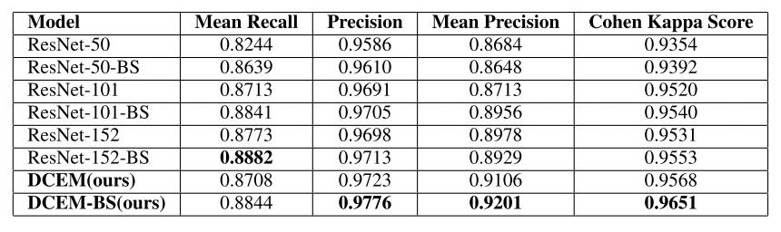
Recent Deep Ensemble research
W. Liu, M. Zhang, Z. Luo and Y. Cai, "An Ensemble Deep Learning Method for Vehicle Type Classification on Visual Traffic Surveillance Sensors,"
Balanced sampling data augmentation strategy to increase the number of samples of rare classes in the original dataset
Multiple Convolutional neural network models are trained with different residual learning frameworks (initialization pretrained on ImageNet for all)
Outputs of CNN models combined by maximum voting policy
Best individual CNN
Ensemble
W. Liu, M. Zhang, Z. Luo and Y. Cai, "An Ensemble Deep Learning Method for Vehicle Type Classification on Visual Traffic Surveillance Sensors," in IEEE Access, vol. 5, pp. 24417-24425, 2017, doi: 10.1109/ACCESS.2017.2766203.

Slide 24
Recent Deep Ensemble research
Huang G, et al: Snapshot Ensembles: Train 1, Get M for Free
Ensembles of neural networks more robust than individual networks but training multiple deep networks for model averaging is computationally expensive
In gradient descent, number of possible local minima grows exponentially with number of parameters. Two identical architectures optimized with different initializations or minibatch orderings will converge to different solutions.
Although different local minima often have very similar error rates, the corresponding neural networks tend to make different mistakes. This diversity can be exploited through ensembling, in which multiple neural networks are trained from different initializations and then combined with majority voting or averaging
Snapshot Ensembling saves models at each local minimum then continues training
Ensemble of snapshot models yielded lower error rates than single models at no additional training cost, and compare favorably to traditional network ensembles
Huang G, Li Y, Pleiss G, et al (2017a) Snapshot Ensembles: Train 1, Get M for Free. In: International Conference on Learning Representations 2017

Slide 25
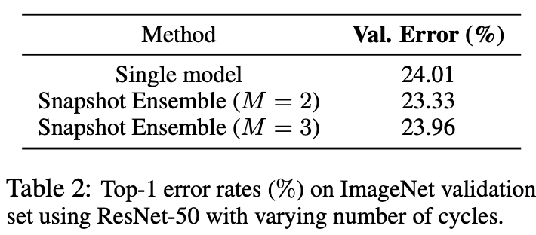
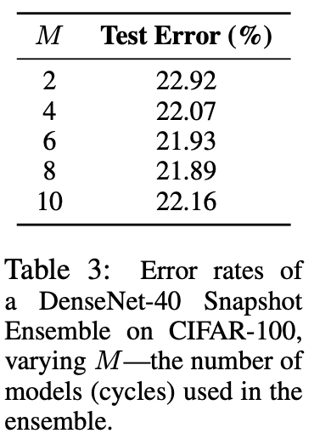
Snapshot Ensemble Results
Notice that pruning matters here too, adding more snapshots to ensemble doesn’t keep reducing error rate
Huang G, Li Y, Pleiss G, et al (2017a) Snapshot Ensembles: Train 1, Get M for Free. In: International Conference on Learning Representations 2017

Slide 26
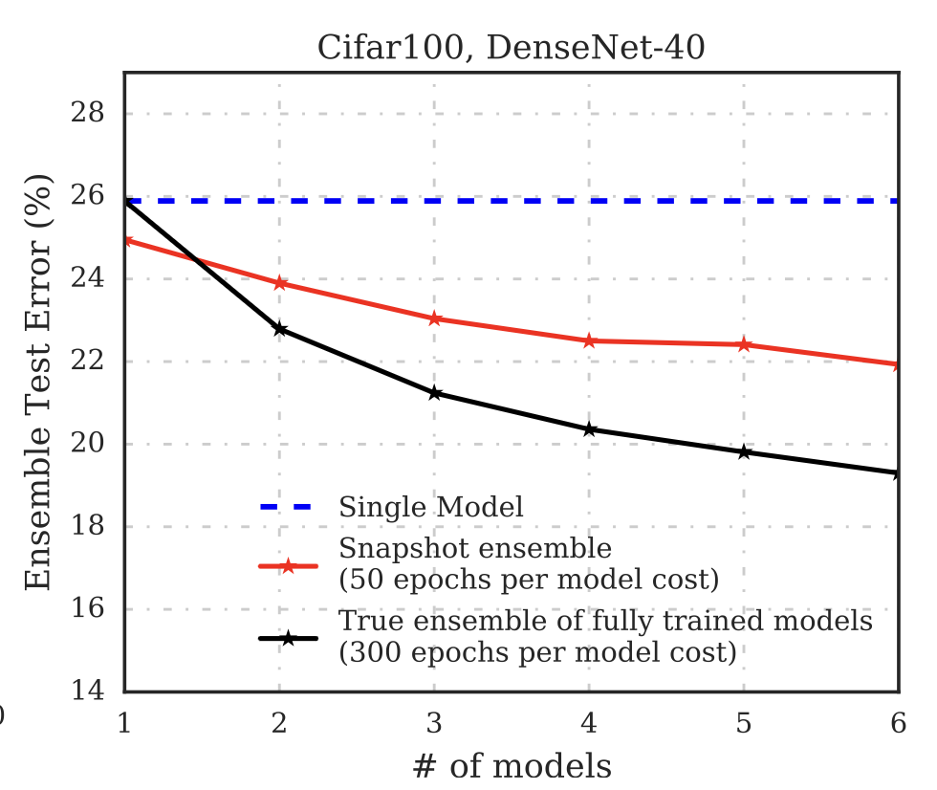
Snapshot Ensemble Results
Snapshot Ensemble didn’t produce as low error as true ensemble of multiple fully trained models
But remember that red line is #snapshots in one model, so at the right end of chart it’s training time is approximately 1/6th that of the fully trained true ensemble
Huang G, Li Y, Pleiss G, et al (2017a) Snapshot Ensembles: Train 1, Get M for Free. In: International Conference on Learning Representations 2017

Slide 27
References
A Survey on Ensemble Learning under the Era of Deep Learning:
https://github.com/rickfontenot/ML2/blob/main/ensemble/research/2101.08387.pdf
A Comparative Study of non-deep learning, deep learning, and ensemble learning methods:
https://github.com/rickfontenot/ML2/blob/main/ensemble/research/2203.05757.pdf
Ensemble Methods: Foundations & Algorithms (book By Zhi-Hua Zhou):
https://github.com/rickfontenot/ML2/blob/main/ensemble/research/EMFA_compressed.pdf
Clustering ensembles of Neural Network Models:
https://github.com/rickfontenot/ML2/blob/main/ensemble/research/1-s2.0-S0893608002001879-main.pdf
Alzheimer’s Disease Neuroimaging Initiative:
https://github.com/rickfontenot/ML2/blob/main/ensemble/research/1-s2.0-S1361841517300166-main.pdf
An Ensemble Deep Learning Method for Vehicle Type Classification on Visual Traffic Surveillance Sensors:
https://github.com/rickfontenot/ML2/blob/main/ensemble/research/An_Ensemble_Deep_Learning_Method_for_Vehicle_Type_Classification_on_Visual_Traffic_Surveillance_Sensors.pdf
Snapshot Ensembles: Train 1, Get M for Free
https://github.com/rickfontenot/ML2/blob/main/ensemble/research/snapshot_ensembles_train_1_get.pdf

Slide 28
Appendix

